Slide 1
Innovative teaching methods What is innovation?

Slide 2
“something new” “a new method or device”
Why innovate?…

Slide 3
Innovation
in
the
Classroom
=
A vehicle for Progress
How can I get my students to….

Slide 4
Think?
Method….

Slide 5
PBL
Problem
based
learning
So what is
problem based learning…

Slide 6
Learners are engaged by problems which are….
open ended
meaningful
aligned to the curriculum…
How does the process work?….

Slide 7
Problem-Solving Process
problem defined
information shared
think tank
evaluation
select best solutions
Example….

Slide 8
PBL in practice
Spaghetti Bridge
Result reflects practicality and academia
BUT…

Slide 9
Why
use
Problem
based
Learning?
PBL creates….

Slide 10
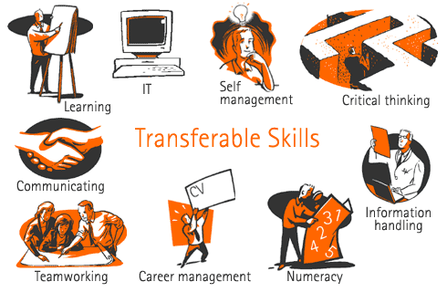
Transferable skills
With a purpose….

Slide 11
PBL prepares students to think critically and analytically, and to find and use appropriate learning resources.
And there's more….

Slide 12
With
PBL
students
Experience
ICEDIP….

Slide 13
Innovation creates motivation + impulse +momentum.
I= Inspiration

Slide 14
Clarification
Students formulate questions
What am I trying to achieve, say, solve ? Where could this idea take me?

Slide 15
Evaluation
Students evaluate their own and their peers work
weaknesses = opportunities

Slide 16
Distillation
Students choose The best ideas

Slide 17
Incubation
Students learn to work on problems within a designated time-frame and group setting.

Slide 18
Perspiration
Students learn that Perspiration requires: positivism,persistence,commitment,engagement and early response to any shortcomings.

Slide 19
Inspiration Clarification Evaluation Distillation Incubation Perspiration
six aspects of PBL…

Slide 20
This powerpoint was kindly donated to www.worldofteaching.com
http://www.worldofteaching.com is home to over a thousand powerpoints submitted by teachers. This is a completely free site and requires no registration. Please visit and I hope it will help in your teaching.

